Slide 1
7A
AT THE NATIONAL PORTRAIT GALLERY

Slide 2
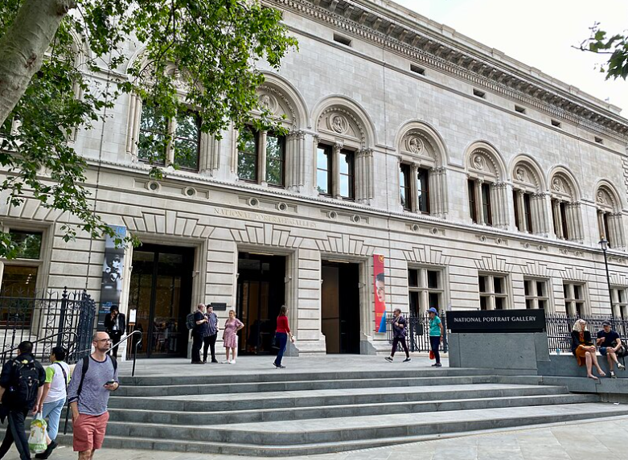
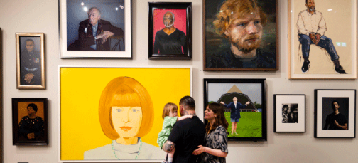
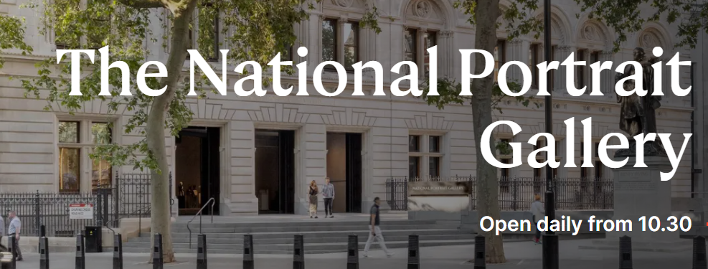

Slide 3
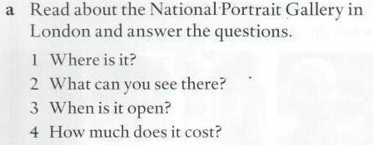
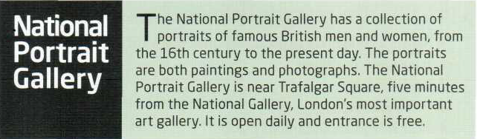
It’s near Trafalgar Square, in London
A collection of portraits of famous British men and women
It’s open every day/daily
Nothing. It is free.

Slide 4

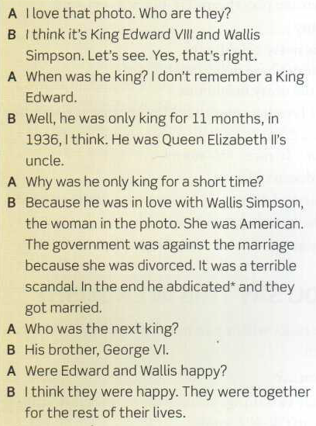
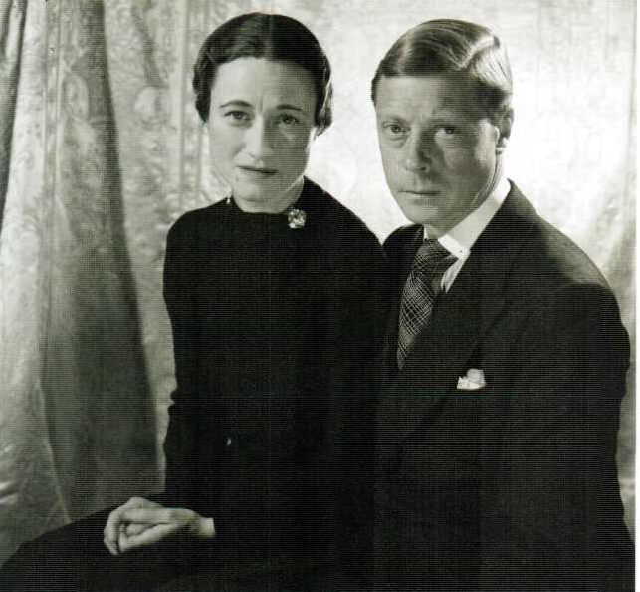
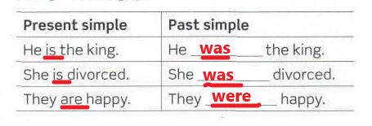

Slide 5
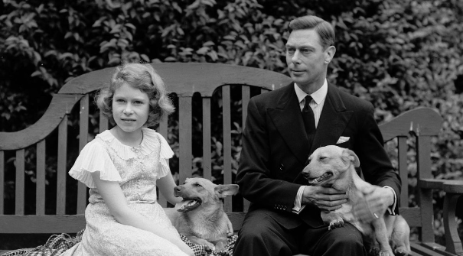
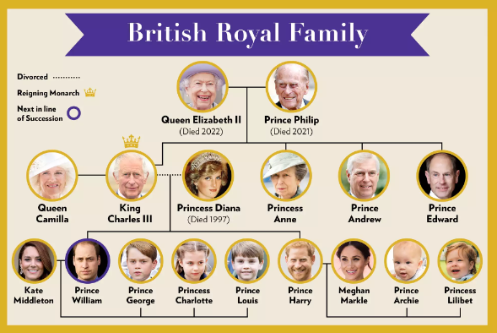
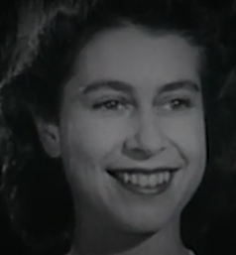
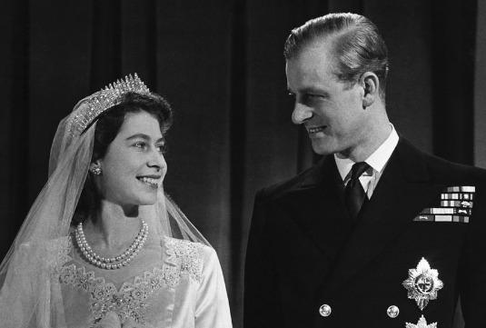

Slide 6
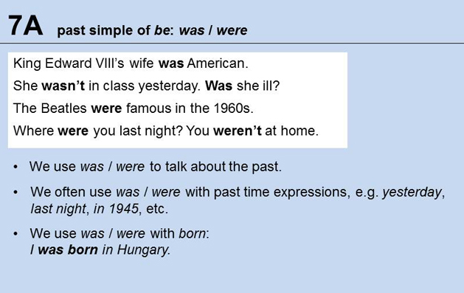
PAST SIMPLE VERB BE
BE BORN

Slide 7
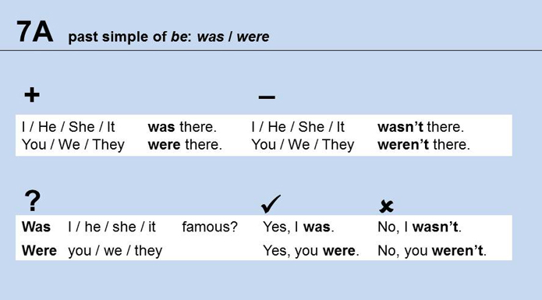

Slide 8
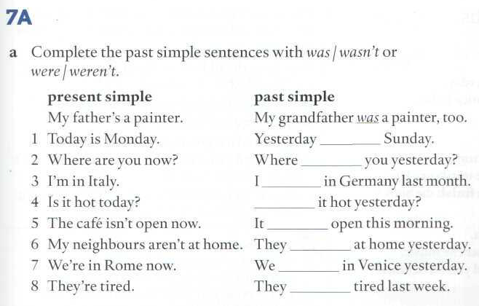
was
were
was
Was
wasn’t
weren’t
were
were

Slide 9
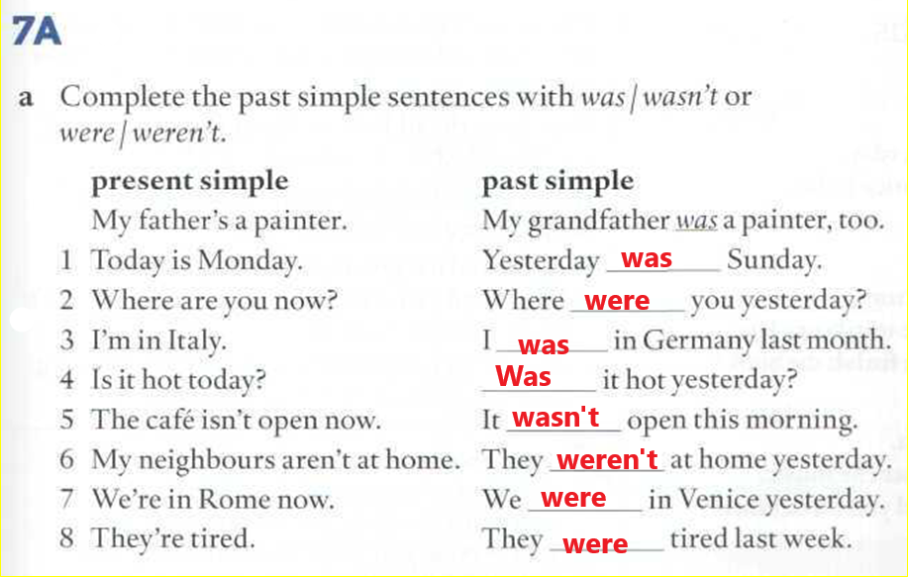

Slide 10
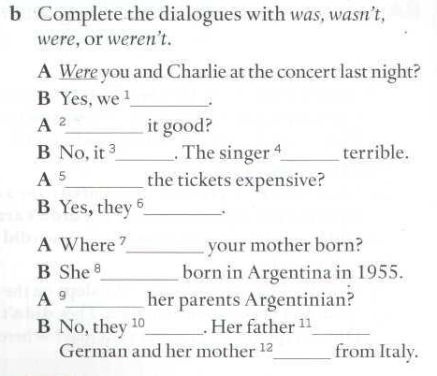
were
was
wasn’t
was
were
Where were you born?
When were you born?
Where was your father/mother born?
Where were your grandparents born?
When was your best friend born?
were
was
was
were
BE BORN
Weren’t
was
was

Slide 11
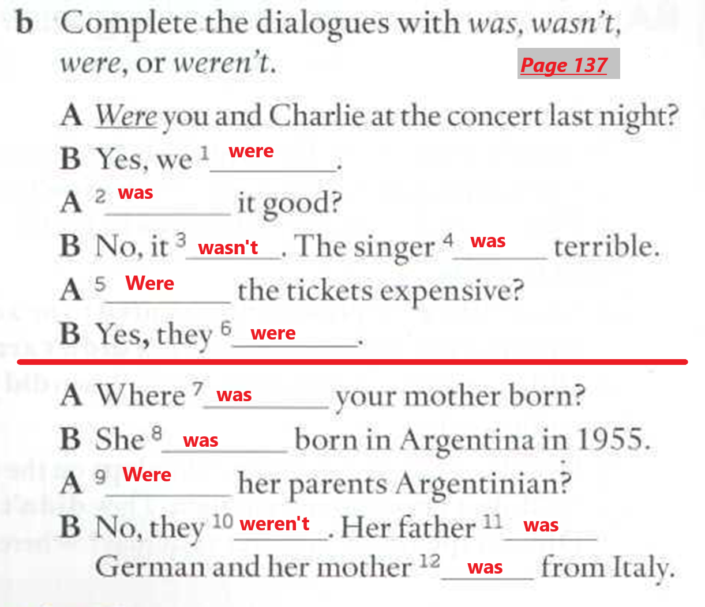

Slide 12
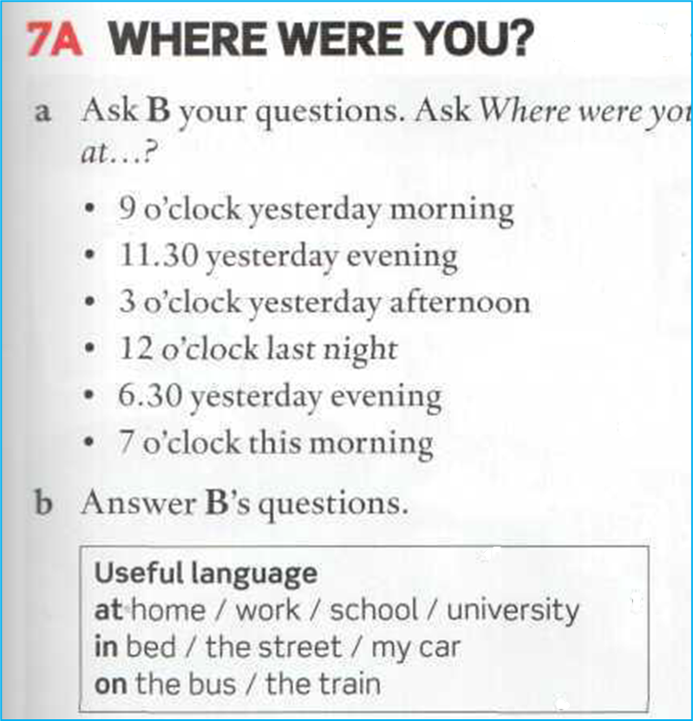
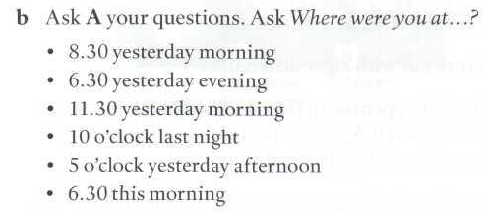
WHERE WERE YOU YESTERDAY?
ORAL ASSIGNMENT

